Slide 1
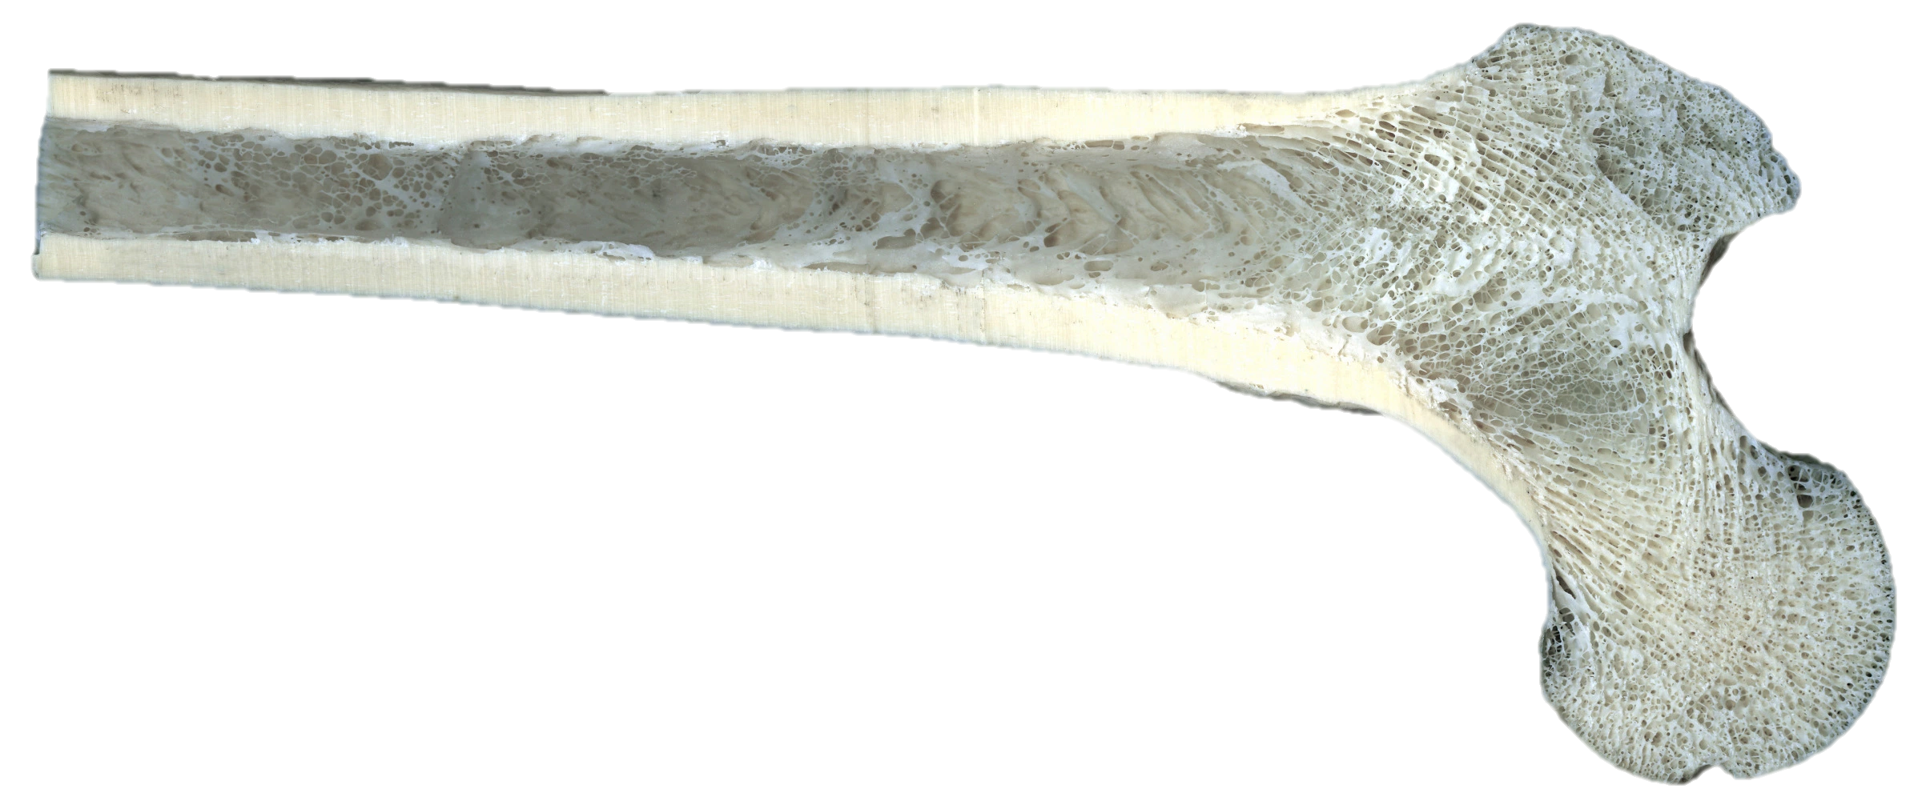
Daily Review
Vocabulary
Porous: has many holes
Structure of Bones
There are two types of bone tissue:
Compact bone is dense and heavy, for strength.
Spongy bone is porous, which makes it light.
Think, pair, share: How is spongy bone different to compact bone in terms of its structure?
Think, pair, share: How is spongy bone different to compact bone in terms of its function?

Slide 2
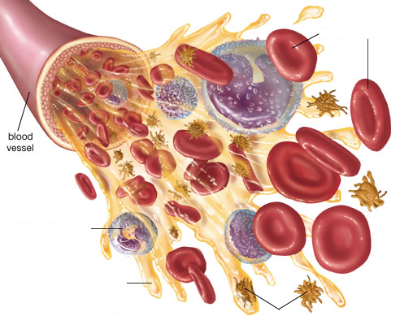
Daily Review
Components of Blood
The blood is a liquid organ that has four different components.
Think, Pair, Share: list the four components of blood.

Slide 3
Daily Review
Components of Blood
On your whiteboard, match the following blood components to the corresponding letter on the diagram. (Don’t erase them)
Match the function of the blood components below.
1 Clots blood
2 Fights diseases
3 Carries oxygen
4 Carries nutrients, wastes, hormones
A
B
C
D

Slide 4
Circulatory System - Circulation

Slide 5
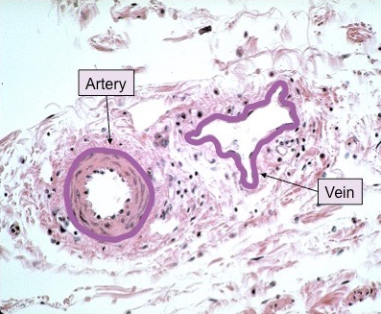
Learning Objectives
CFU
What are we going to learn?
Describe the path blood takes through the body
Activate Prior Knowledge
Blood is carried through the body through blood vessels: arteries, veins and capillaries.
Think, Pair, Share: Describe two differences between veins and arteries.

Slide 6
Concept Development
CFU 1
What is the first step in a heart beat?
CFU 2
Where does the blood flow to from the atria?
The Heart Contracts and Relaxes
The heart beat begins when the heart muscles relax and blood flows into the atria.
The atria then contract and the valves open to allow blood into the ventricles.
CFU 3
Think, Pair, Share: What are the name of the valves between the atria and the ventricles?
blood from the body
blood from the lungs

Slide 7
Concept Development
CFU 1
What is the function of valves in the circulatory system?
CFU 2
What is the effect of contraction of the ventricles?
The Heart Contracts and Relaxes
The valves close to stop blood flowing backwards.
The ventricles contract forcing the blood to leave the heart.
At the same time, the atria are relaxing and filling with blood again.
The cycle then repeats continuously.
CFU 3
Think, Pair, Share: Consider this – how many times (on average) does a heart beat every day? 4,320 beats 103,680 beats 37,843,200 beats 2,838,240,000 beats
Fun Fact
With an average heart rate of 72 bpm: 4,320 beats an hour 103,680 beats a day 37,843,200 beats a year 2,838,240,000 beats a lifetime
https://www.youtube.com/watch?v=5tUWOF6wEnk

Slide 8
Concept Development
CFU 1
Why is the circulatory system a double pump system?
CFU 2
Explain the difference between the left and right sides of the ‘pump’.
Double Pump System
The circulatory system is a double pump system.
It is called this because there are two separate circuits through which the blood flows.
The right side deals with deoxygenated blood.
The left side deals with oxygenated blood.
Lungs
Body cells

Slide 9
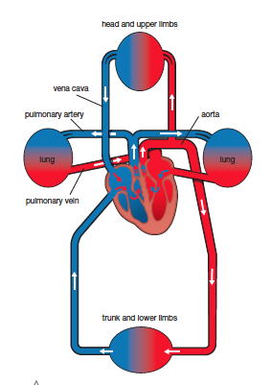
Concept Development
CFU 1
Explain the difference between the two pathways of blood in the body.
CFU 2
Think, Pair, Share: Where does deoxygenated blood flow to after leaving the heart?
Circulation in the Body
In one circuit, the blood flows from the heart to the body and back to the heart.
This circuit carries nutrients and oxygen to the cells.
At the cells, it collects wastes, including carbon dioxide.
The other circuit goes from the heart to the lungs.
In the lungs, carbon dioxide passes out of the blood and oxygen passes into the blood.
The blood rich in oxygen then returns to the heart to be pumped around the body.

Slide 10
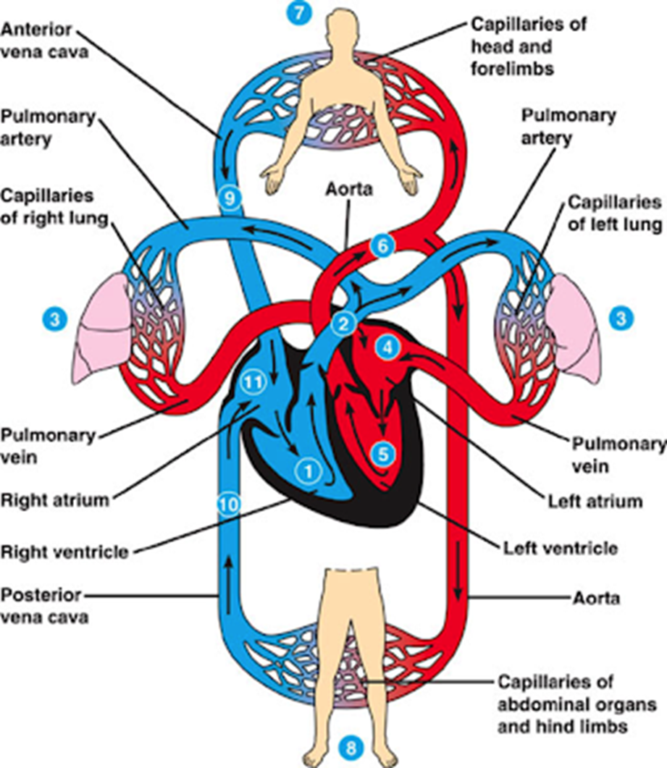
Skill Development/Guided Practice
Describing the path of blood through the heart
1. Identify the starting point on the diagram 2. State whether the blood is oxygenated (red) or deoxygenated (blue) 3. Follow the arrows through the different parts of the body
Describe the path of blood from the lungs (3) to the heart.
The oxygenated blood returns to the heart through the pulmonary vein.

Slide 11
Skill Development/Guided Practice
Describing the path of blood through the heart
1. Identify the starting point on the diagram 2. State whether the blood is oxygenated (red) or deoxygenated (blue) 3. Follow the arrows through the different parts of the body
Describe the path of blood from the head and forelimbs(7) to the heart.
The deoxygenated blood returns to the heart through the vena cava.

Slide 12
Skill Development/Guided Practice
Describing the path of blood through the heart
1. Identify the starting point on the diagram 2. State whether the blood is oxygenated (red) or deoxygenated (blue) 3. Follow the arrows through the different parts of the body
Describe the path of blood from the right atrium (11) to the lungs (3).
The deoxygenated blood from the right atrium goes to the right ventricle, then goes through the pulmonary artery to the right and left lung.

Slide 13
Skill Development/Guided Practice
Describing the path of blood through the heart
1. Identify the starting point on the diagram 2. State whether the blood is oxygenated (red) or deoxygenated (blue) 3. Follow the arrows through the different parts of the body
Describe the path of blood from the left atrium (4) to the abdominal organs and hind limbs (8).
The oxygenated blood from the left atrium goes to the left ventricle, then goes through the aorta to the abdominal organs and hind limbs.

Slide 14
Skill Development/Guided Practice
Describing the path of blood through the heart
1. Identify the starting point on the diagram 2. State whether the blood is oxygenated (red) or deoxygenated (blue) 3. Follow the arrows through the different parts of the body
Describe the path of blood from the abdominal organs(8) to the lungs (3).
The deoxygenated blood from the abdominal organs goes through the vena cava to the right atrium, then the right ventricle. It then goes through the pulmonary artery to the lungs.

Slide 15
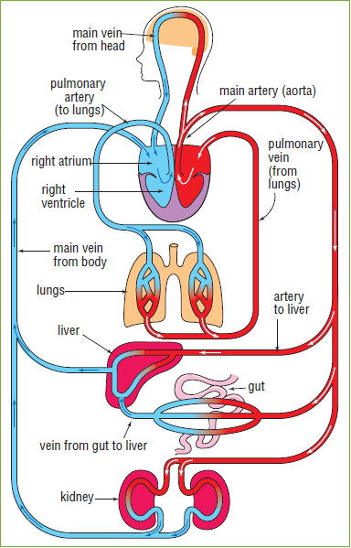
Complete the second page of the Blood and Circulation worksheet from last lesson.
Independent Practice

